Slide 1
An Analysis on Social Biases in Comic Characters
Morgan McCarty

Slide 2

Background on the Dataset
The data set has two portions
Marvel (from the Marvel Fandom)
DC (from the DC Fandom)
There are 13 data fields of which 8 are fully categorical (technically 9 including the name), 2 are partly (years), and 3 are metadata (including the name)
The DC and Marvel datasets are exactly the same minus two tiny differences in the name of one column and the formatting of dates
It was created by FiveThirtyEight for an analysis on women in comics in 2014
https://github.com/fivethirtyeight/data/tree/master/comic-characters

Slide 3

Why Should we Care About Biases in Comics?
The Marvel Cinematic Universe has grossed over 30 billion USD
Batman has grossed over 29 billion USD
Spider-man has grossed over 25 billion USD
What was once a relatively niche topic is now a mainstream facet of life
Children grow up idolizing superheroes

Slide 4



Step 1 - Biases Before Learning
Before we even discuss the models and their architecture as well as what they can show we need to look at some data
Combined between both Marvel and DC there are:
16421 Male Characters
5804 Female Characters
68 Characters who fall under a different sex/gender identity (as well as 979 NaN characters)
Immediately it’s clear that there is a massive gender gap within comic book characters (2.829x as many men as women, and for characters who are neither Male nor Female the gap is even larger)
As of 2014 there were only 2 transgender characters in Marvel or DC

Slide 5

Step 2 - The Model (High Level)
How can we design a model which can look at various social biases without introducing biases of its own?
Random Forest:
Easily interpretable and easily visualizable
Can build a lot of these to see what causes different results

Slide 6
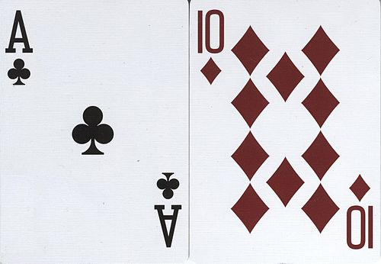
Step 3 - Data Preprocessing
Unfortunately the data is not perfect as such there are three main steps
Convert the dates to a standardized number between datasets
One-hot encode any categorical feature that is not the target feature and label encode the target vector
Replace NaNs with the mean value for the class
With seven categorical features, and three datasets, 21 Random Forests were made
As such a standardized process is essential
If there was a NaN target feature, its row was removed for that model

Slide 7
Step 4 - Training
As with any set of models being built disjointly, but at the same time, it was very important to make sure the data was properly separated
Separated data two ways
20% of the data was immediately separated away to make a validation set
On the remaining 80%: GridSearchCV with StratifiedKFold (the number of folds depended on the feature)
Data is doubly protected from leaking between the train and test

Slide 8
Step 4 Continued - Grid Search
Random Forests have several hyperparameters
Five key hyperparameters were chosen to improve the performance of the model
“n_estimators”, “min_samples_split”, “min_samples_leaf”, “criterion”, “max_depth”
Key points: “criterion” is the evaluation function for splits, “n_estimators” is the number of Trees in the forest
More hyperparameters or a larger grid range of these could have been considered, but the time to evaluate the best parameters rose very quickly

Slide 9
Step 4 Continued - StratifiedKFold
StratifiedKFold was applied to reduce the bias and variance within the models
The number of folds was set to min(n, 5) where “n” is the number of class examples of the smallest class
If “n” were less than 2 (i.e. 1) then the StratifiedKFold and GridSearch had to be skipped (this occurred on several of the categories)

Slide 10
Step 5 - Results (Accuracy)
While more metrics were looked at within the code accuracy is the easiest to view across all 21 Random Forests
Marvel: ALIGN - 0.6030, SEX - 0.7314, EYE - 0.4735, HAIR - 0.3033, GSM - 0.8333, ALIVE - 0.7679, ID - 0.5781
DC: ALIGN - 0.6243, SEX - 0.6937, EYE - 0.4602, HAIR - 0.2972, GSM - 0.8461, ALIVE - 0.7519, ID - 0.6530
Combined: ALIGN - 0.6062, SEX - 0.7481, EYE - 0.4038, HAIR - 0.2954, GSM - 0.7741, ALIVE - 0.7707, ID - 0.5714
accuracies above .7 are highlighted

Slide 11
Step 5 Continued - Interpreting the Results
The numbers don’t show much without some context
ALIVE is the only binary classification topic (i.e. Living Characters or Deceased Characters) [though as discussed earlier SEX is divided fairly binarily]
EYE and HAIR both have the most classes (26 and 28 respectively)

Slide 12
Step 5 Continued - Interpreting the Results (SEX and GSM)
For the purpose of analyzing biases, SEX and GSM are the two most important features
Let’s look at some charts!

Slide 13
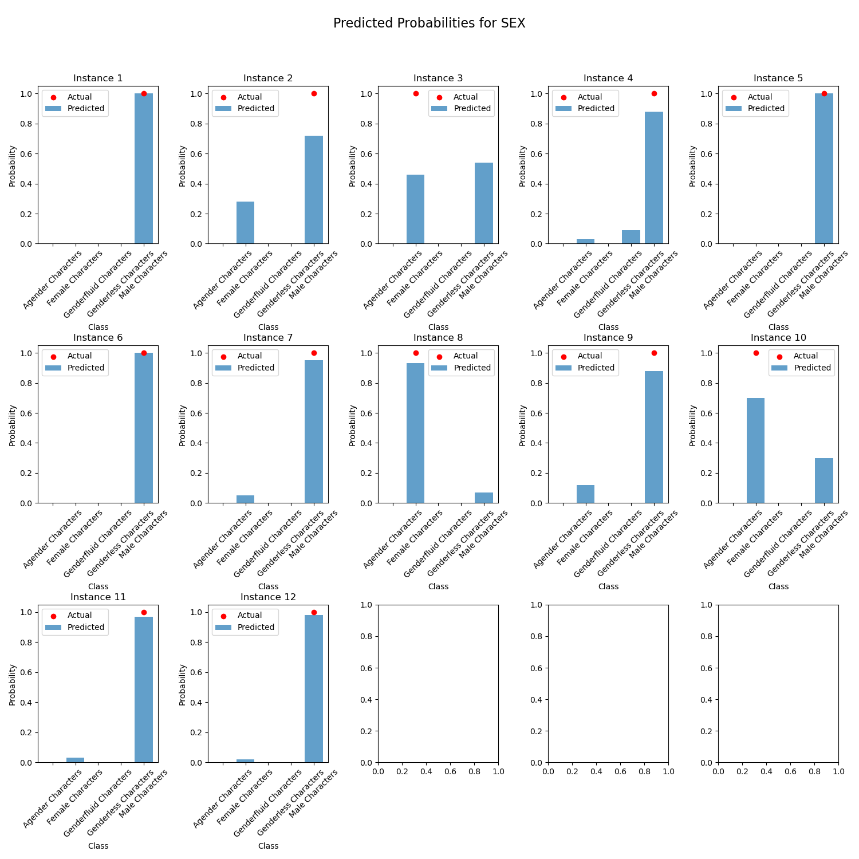
Step 5 Continued - Interpreting the Results (SEX and GSM)
These are 12 random instances in which you can see the probability distributions created for each character
Male is dominant throughout as expected
n.b. there was an unfortunate error in the name transcription for Marvel and DC which caused the name to be pretty much random - combined was just left as “instance”

Slide 14
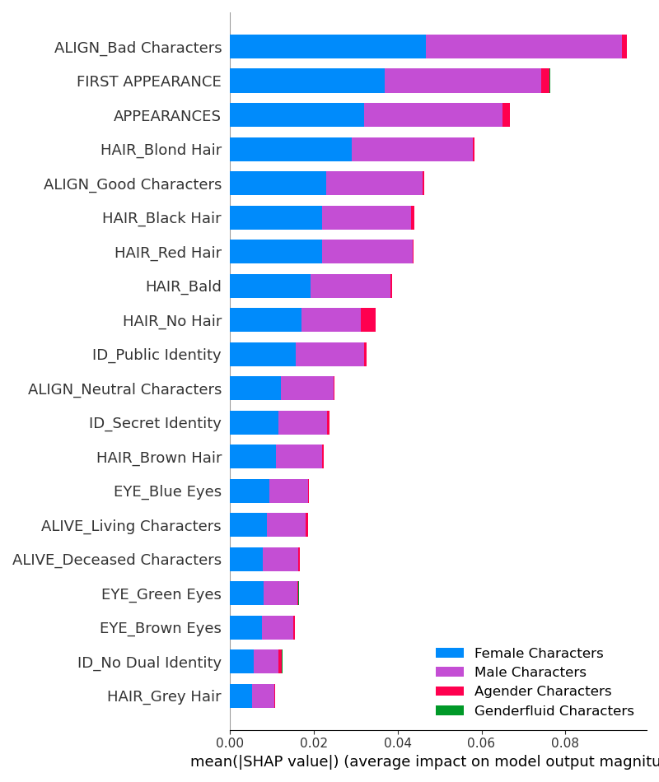
Step 5 Continued - Interpreting the Results (SEX and GSM): Marvel
Almost immediately something about this chart jumps out
The biggest contributor to Agender Characters is having no hair
Looking at the data this can be partially explained by the presence of the symbiotes (aliens) [which also correlates to the villain presence of agender]
However this reduces non-binary representation within Marvel to hairless individuals

Slide 15
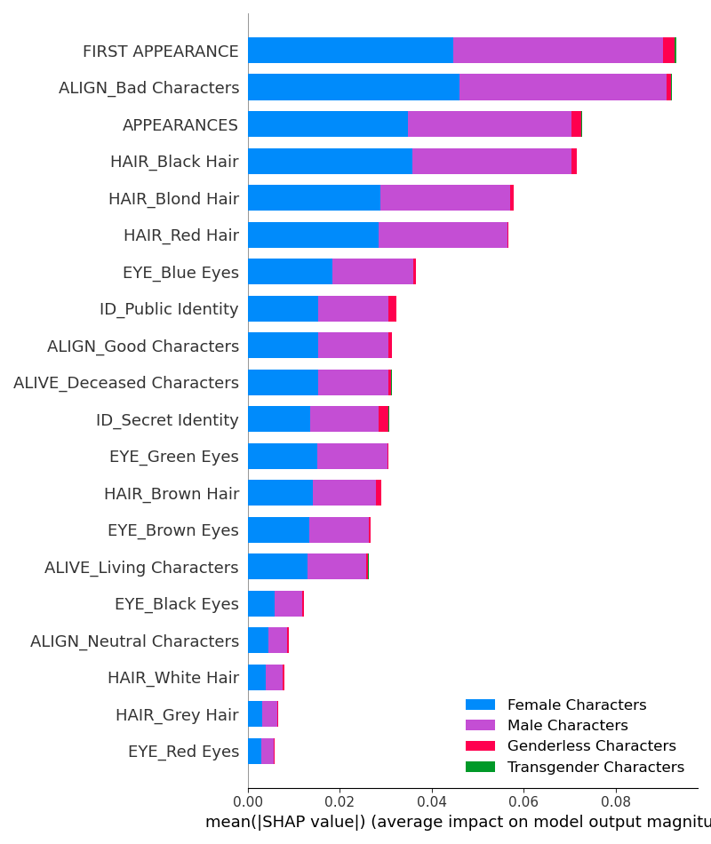
Step 5 Continued - Interpreting the Results (SEX and GSM): DC
DC graph gives us another chance to consider similar things to the Marvel graph
Value shown on graphs is mean absolute value of the importance of a feature for its class
Hair color is a strong indicator for sex in DC
Features which should be strongly discorrelated to sex seem very important here
Some features do make sense, however, like the first appearance having a strong role due to the increased presence of female characters as time has passed

Slide 16
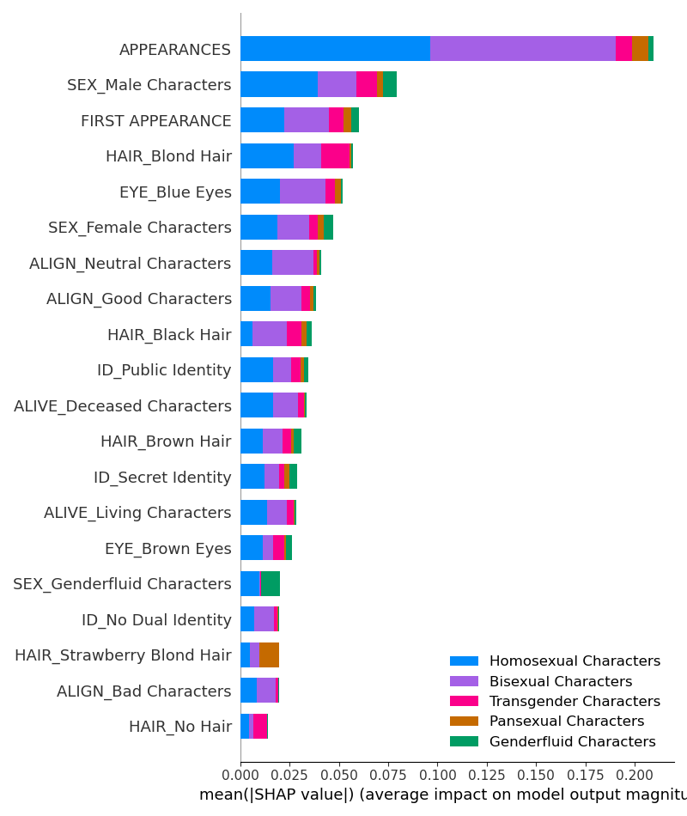
Notes on Results (GSMs in Marvel)
Gender and Sexual Minorities are another important consideration
Very few within the dataset
Two of the highest contributing factor to GSMs: number of appearances, first appearance
GSMs a recent change for Marvel
High mean absolute value of appearances shows large room for improvement

Slide 17
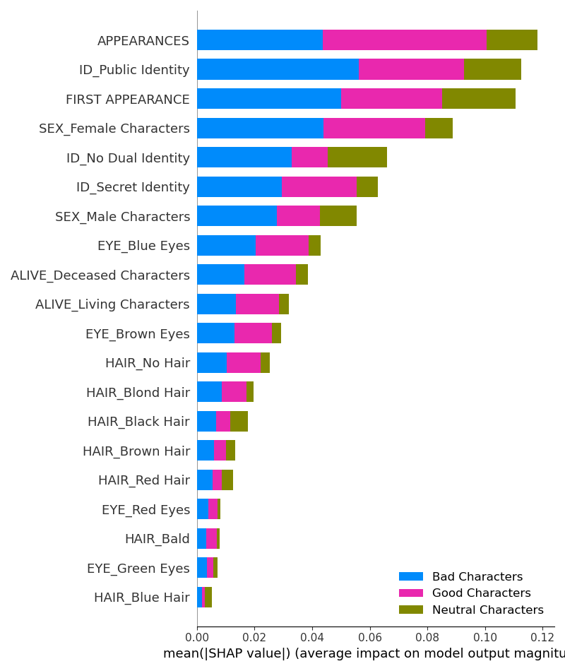
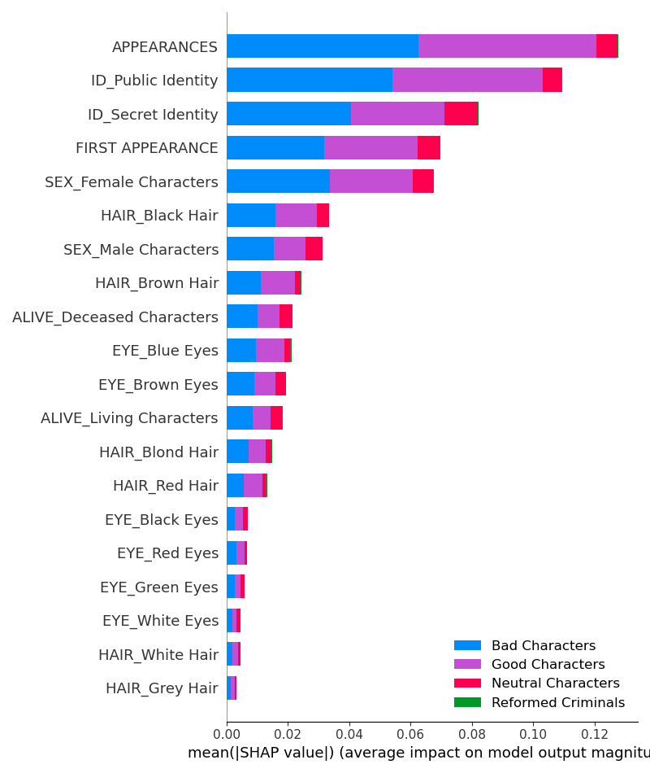
Alignment (Marvel, DC)

Slide 18
Ending Notes
The data and predictions from the data show a few key points
Marvel and DC have been improving over time with regards to inclusivity, but both have a long way to go until they are properly inclusive of women and GSMs
SEX and GSM as categories both are too heavily influenced by non-gendered physical characteristics (eye color, hair color)
As such it holds that comics are very gender and inclusivity biased

